Slide 1
Presentation
Name : M.Umair Islam
Roll No : BSCS-F19-A-57
Section : B - Morning
Title : Critical Analysis Of Software Failure

Slide 2
Introduction :
With the growth of technology, people and companies are more relying on software systems. For that, we need a product/software that is trustworthy, reliable,maintainable and useabale.
For software to become successful it has to go through these steps: Communication, planning, modeling, construction, and deployment.
Factors which can make software to fail are badly or poorly defined requirements, unmanaged risks, poor communication between customers, users and developers, poor project management,
There is any bug in the software then not only the software will fail but it will also affect the organizations that are responsible for making it. So the failure of software also has a great impact on the organization.
In this research, I am going to present a detailed and critical analysis of all those causes due to which the software fails and the factors that affect in a project success.
We will study the existing software development processes and also analyze how they can helpful in reducing these causes.

Slide 3
Literature Review:
References | Method | Conclusion
 | When a project is being made the team members are sometimes not playing their part which can cause clashes in the team and can affect the overall project. | The software projects were failed due to the numerous factors.
 | a great pressure of upper-level management on the development team and project managers | The pressure affects the performance of the team which has a bad effect on the project
 | He explains that software project frequently failed as they are not 100% perfect | Software not completely reliable and contains errors
 | Mostly the reason behind the failure is over budget or when it is delivered to the client it is not what the client has wished for or what the client actually needed. | Software fails due to large number of employees and take a lot of time to complete as well and fails due to how much knowledge and skills an employee has about the development of that software.
 | The qualities which successful projects have are meeting business goals; deliver on time, complete in a budget and meeting the customer requirements. | Not Completes on required time, and budget and can‘t fulfil the user requirements
[1]
[2]
[3]
[4]
[5]

Slide 4
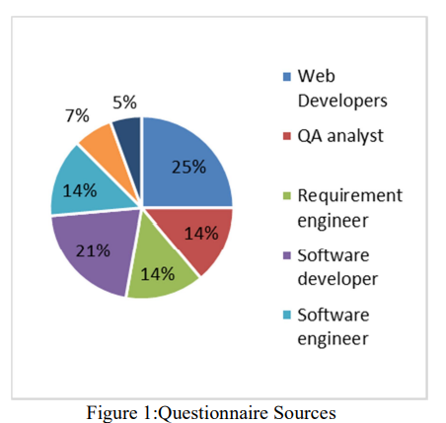
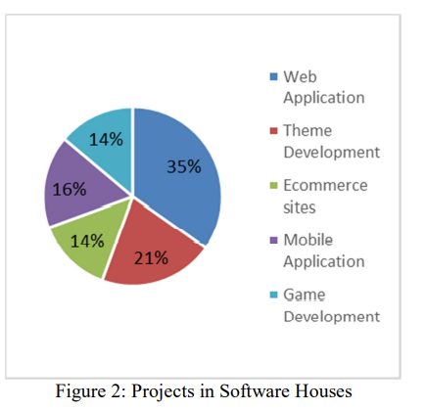
Analysis:
To do a critical analysis of those causes and give reasons due to which most organizations move towards the failure. We will also focus on those causes that how they affect a software system which can cause organizations to have a bad repute.
To study and identify the best software development model from the existing ones which can help to overcome the causes of software failure making the status of the organization high which is responsible for making that specific software.
Information Collections :

Slide 5
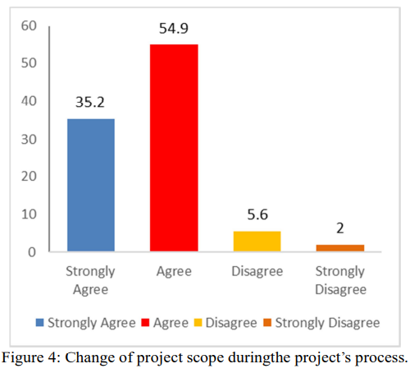
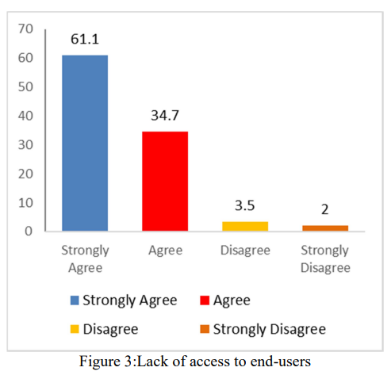
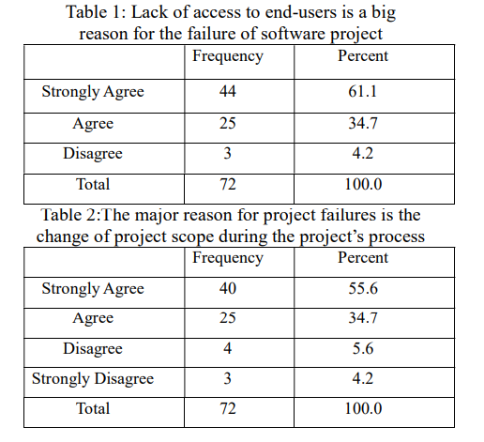
Information Collections :

Slide 6
Discussion and Future work:
The identification of main reasons and causes that are hurdles to reputation of the software house are totally dependable on the success of a software system which will be the major outcome of this research.
We have also explained some factors which have been affecting the software to fail. These factors include incomplete requirements, Ambiguous goals, time shortage, cost management, lack of user involvement during the development.
Our future work will be that we will be minimizing the faults and errors, factors which cause software to fail so that the software can be a success for both the client and the organization.
Software development is a very vast field in which software need to pass through different process till it finishes the processes are Communication, planning, modeling, construction, and deployment.
The main issue of failure that is gathering of requirements if it performed accurately then all other tasks will be performed accurately.

